Slide 1
KYNDRYL Shared Infra CH
Azure Landing Zone – IAM
Wojciech Pazdzierkiewicz – Infrastructure Architect
4.05.2022

Slide 2
Agenda
01 Identity concept
02 Current landscape
03 Target landscape
04 Proposal

Slide 3
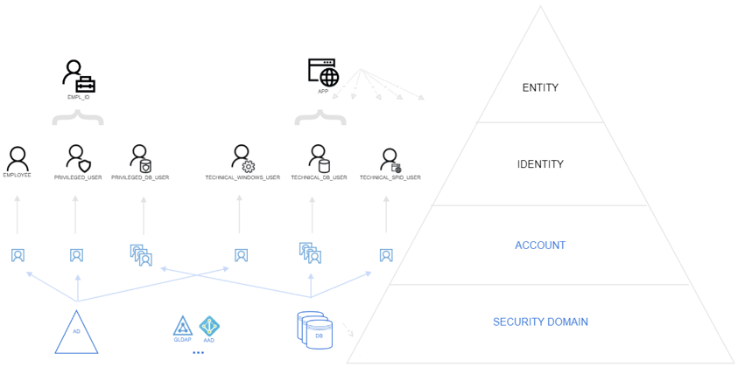
01
Identity concept
Entity item relevant for the purpose of operation of a domain that has recognizably distinct existence
Example: A person, an organization, a device, a group of such items, a human subscriber to a telecom service, a SIM card, a passport, a network interface card, a software application, a service or a website.
Identity set of attributes related to an entity
Attribute characteristic or property of an entity
Example: An entity type, address information, telephone number, a privilege, a MAC address, a domain name are possible attributes.
Domain environment where an entity can use a set of attributes for identification and other purposes
Example: An IT system deployed by an organization that allows users to login is the domain for the user’s login name.
ISO - ISO/IEC 24760-1:2019 - IT Security and Privacy — A framework for identity management — Part 1: Terminology and concepts

Slide 4
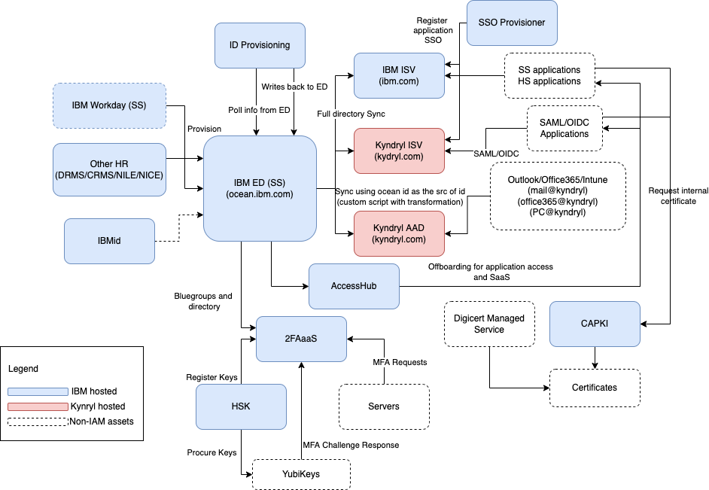
02
CMO

Slide 5
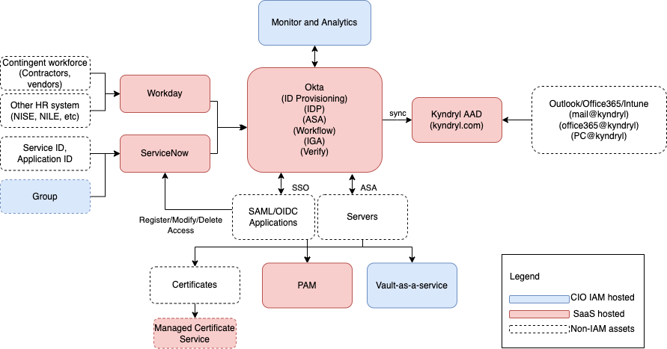
03
FMO

Slide 6
IDs CMO / FMO
Identity
Used For Today
Timing on usage or no longer needed
Approx 400 SSO apps (Box, Slack, Webex, Workday, ServiceNow, etc…)
Somewhere in 3Q22 applications will begin migrating from W3ID (ISV) to W3ID (Okta) and will continue through 2Q23. Application teams will have to make this migration. Federation with W3ID (Okta) will occur in 3Q22 hopefully eliminating the need to use this ID again.
Kyndryl W3ID (ISV)
Kyndryl Microsoft AAD ID
All Microsoft Products (Office 365, Outlook, Teams, etc…)
Federation with W3ID (Okta) will occur in 3Q22 hopefully eliminating the need to use this ID again.
All IBM Soft-Segmented apps, Global Protect (VPN to IBM), w3Publisher, Kyndryl Learning, Buy@Kyndryl, etc…
Transition ID (Ocean)
This ID will remain until the last application/infrastructure service is migrated from IBM to Kyndryl. Before end of TSA (Nov 1, 2023)
All HCL Notes databases, teamrooms, Notes apps, IBM email archive
These ID’s will no longer be supported once the HCL Notes/Domino project is sunset. (Target start of 3Q22)
HCL Notes ID
Kyndryl W3ID (Okta)
All applications (ISV, AAD and any new)
Kyndryl’s will have to setup their initial new ID, password and MFA options sometime in 2Q22.
Kyndryl ID (K-ID)
External Identity Provider (IDP) for customers to authenticate to our external markeplace
This customer facing identity provider will be available in 3Q22. Before it goes live, we will federate it with Kyndryl W3ID so Kyndryls will not need this ID.

Slide 7
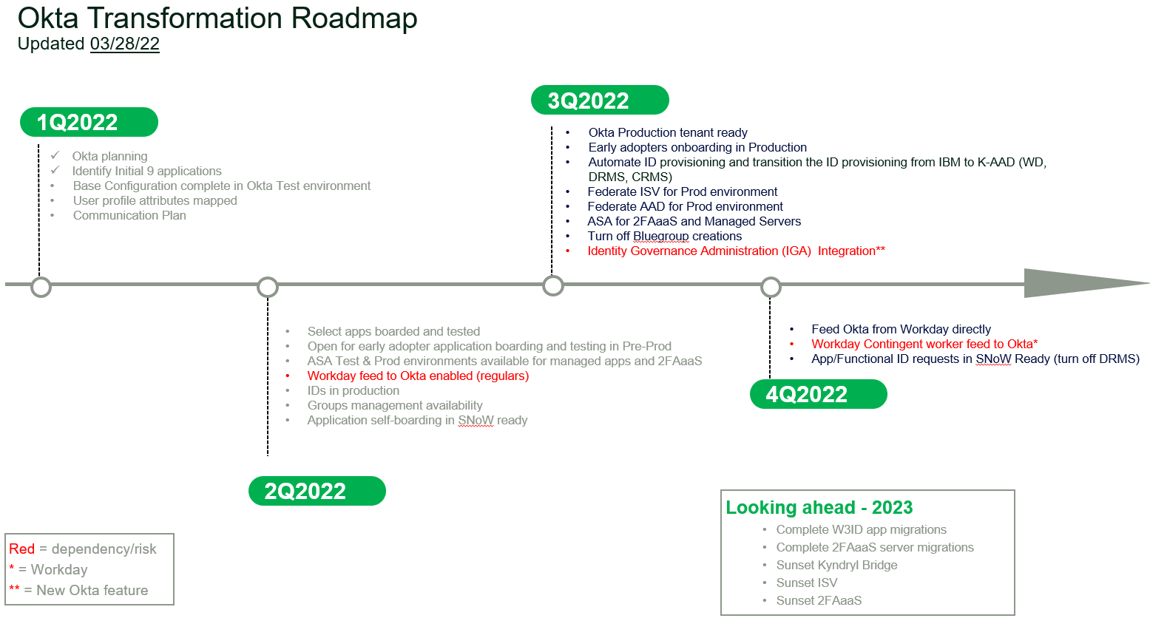
03
FMO

Slide 8
04
Proposal
Isolation of activities on account level
Components:
AAD Identity Protection
Identity Governance
access packages
access reviews
PIM
audit logs
AAD Conditional Access
1 personal identity managed by IDM service
N personal accounts provisioned across Kyndryl security domains for various purposes:
Regular personal corporate account to consume organization applications / services
Privilege personal account(s) to manage customer(s) related resources

Slide 9
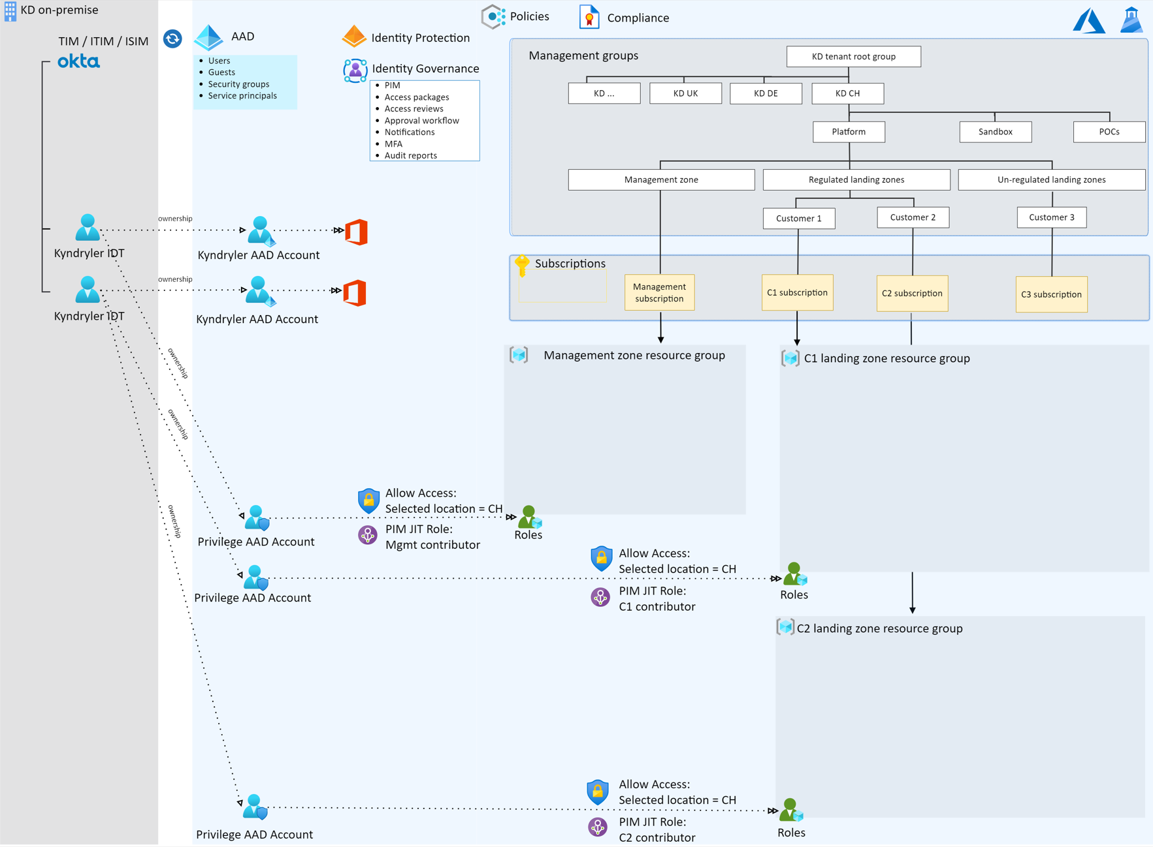
04
Proposal

Slide 10
04
Proposal
Pros:
Separation of duties
Simplify tracking and auditing of activities
Cons:
Additional personal account to manage
Strong relation to personal identity affecting life cycle of both
Dependencies:
OKTA readiness
ID model flexibility

Slide 11
THANK YOU

